Slide 1
Handling high traffic with PHP Applications

Slide 2
PHP is slower than JAVA, C++, GO and node.
PHP has design issues and inconsistencies due to backward compatibility
Scaling PHP code doesn’t matter.

Slide 3
PHP is not your Problem!

Slide 4
You need to Scale the LAMP Stack

Slide 5
LAMP
Linux
Apache
MySQL
PHP

Slide 6
New Stack
Linux + Tuning
NGINX
PHP-FPM
PERCONA
Redis
NSQ

Slide 7
nginx load balancer
nginx
php-fpm
nginx
php-fpm
nginx
php-fpm
nginx
php-fpm
Horizontal scaling
NSQ
Redis
Percona Master
Percona Slave
Percona Slave
Percona Slave
Horizontal scaling

Slide 8
Tuning Linux
open_files
network/sysctl tuning
i/o scheduler

Slide 9
Tuning Linux open_files
default is 1024
/etc/security/limits.conf
soft nofile 65535
hard nofile 65535

Slide 10
Tuning Linux network/sysctl tuning
default is 128
(server starts dropping connections after 128 requests are in queue)
/etc/sysctl.conf
net.core.somaxconn=65536
net.ipv4.ip_local_port_range=1024 65000
(Start Port End Port)

Slide 11
Tuning Linux i/o scheduler
default is cfq
Completely Fair Queuing scheduler for hard disk and MySQL
$ echo “deadline” > \ /sys/block/sda/queue/scheduler
+50% in MySQL Performance

Slide 12
nginx
most popular web server for top 1000 sites
15,000 requests/second
with 20% CPU and 100MB RAM

Slide 13
nginx
load balancer
http cache
fastcgi proxy
web server

Slide 14
php
php is copied in to apache and your code runs inside the apache server
for nginx it looks for some other service or demon to get the executed code

Slide 15
php-fpm
Use static PHP worker pools
4x number of CPU cores
pm=static
pm.max_children=128

Slide 16
php 5.5 is much faster then 5.4 and 5.3
5.5 is 10% faster than 5.4 and 5.4 is 5% faster than 5.3

Slide 17
Update to php 5.5
php 5.5 includes Zend Opcache
10% faster than APC

Slide 18
php horizontal scaling
watch out for sessions
use memcash / Redis for sessions

Slide 19
php + MySQL
MySQL persistent connections are good to use
keeps the connect open

Slide 20
Percona
open source MySQL fork
drop-in replacement for MySQL

Slide 21
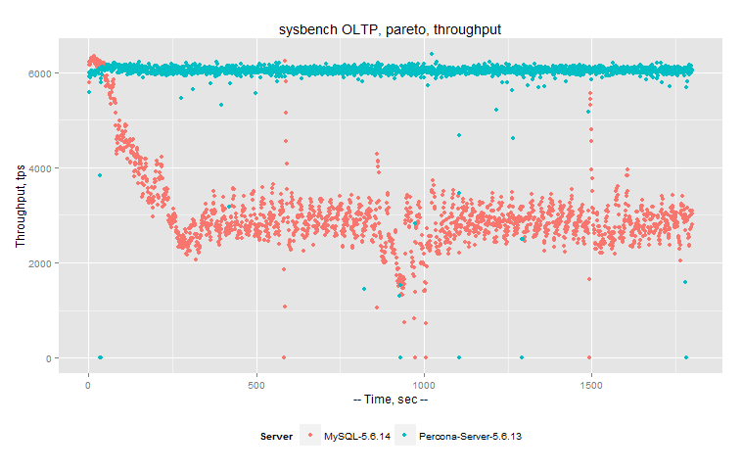
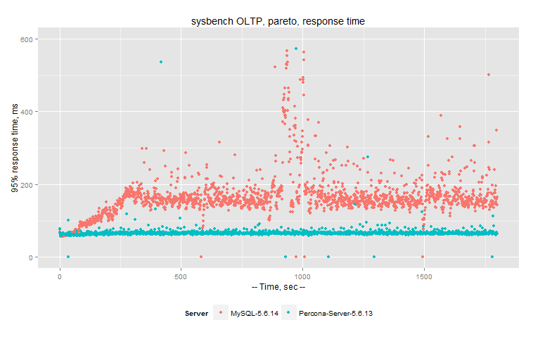
Percona

Slide 22
Percona
persona only uses innodb
disable query cache
thread_handling=pool-of-threads

Slide 23
Percona
Use SSD with higher IOPS

Slide 24
Redis
for saving in memory we can use memcache but redis is better
data persisted to disk and easily be loaded for disk in case the demon crashes
It can handle 500,000 GET/second

Slide 25
nsq
PHP is single thread
If we want to talk to any API it will take time and the process is block for that time, so we use NSQ for this purpose
demon created by bit.ly
nsqphp is the best library

Slide 26
Thanks

